Slide 1

React JS

Slide 2
Component Lifecycle Methods
Module

Slide 3
Lifecycle Methods
When an instance of component is being created and inserted into DOM
When a component is being re-rendered as a result of changes either to its props or its state
When a component is removed from the DOM
When an error occurs while rendering the component, in any of the lifecycle methods or in child components of that component
Mounting
Updating
Unmounting
Error Handling

Slide 4
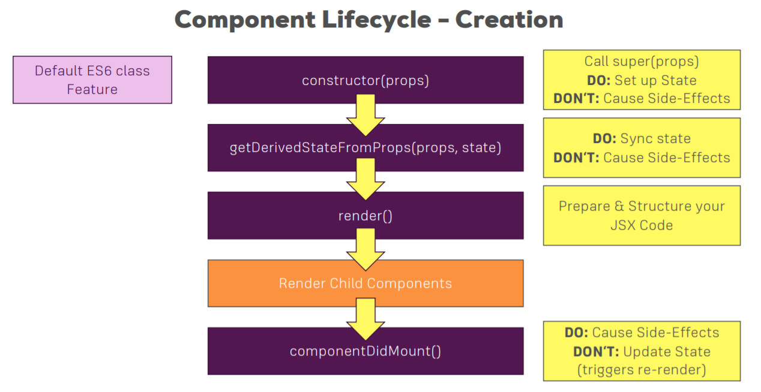
Creation (Mounting)

Slide 5
Mounting
When a component is rendered to the DOM for the very first time, that is called “mounting”
Constructor
Good for initializing state
Do not write code that causes side-effect, such as HTTP calls
Executed once during the lifecycle of the component

